Slide 1

HUMAN ACTIVITY RECOGNITION-VISION BASED APPROACH
PRESENTED BY:
2010030512_L.Keerthana
2010030517_M.Manideepa
2010030526_D.Dedeepya
2010030530_K.Sriteja
GUIDED BY:
DR.ARPITA GUPTHA

Slide 2
OUTLINE
FLOW DIAGRAM
GIT COMMITS
IMPLEMENTATION CODE
OUTPUT
SELECTED MODEL

Slide 3
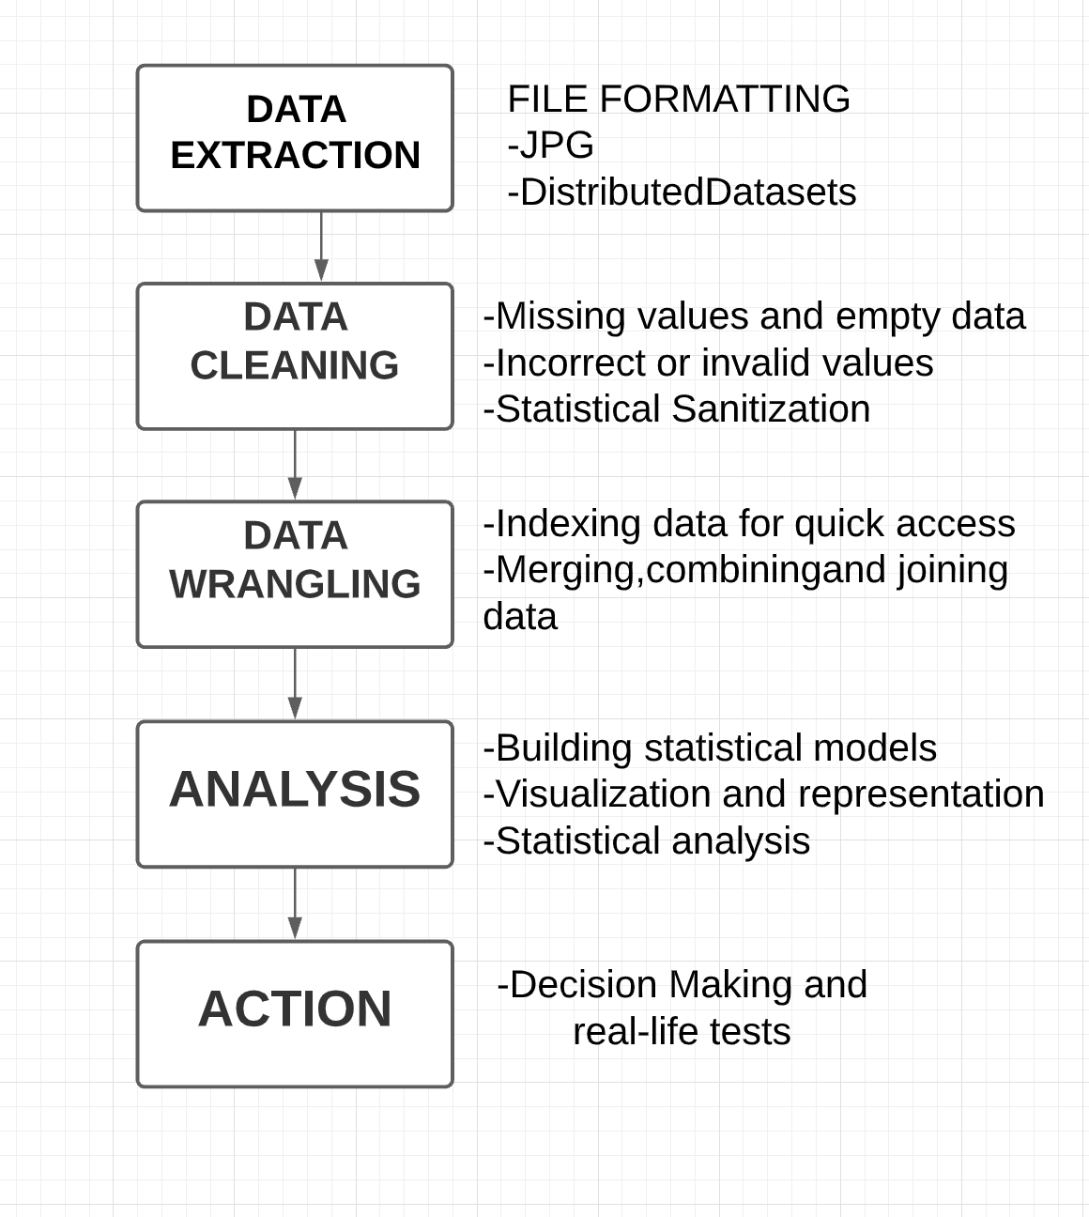
FLOW CHART

Slide 4
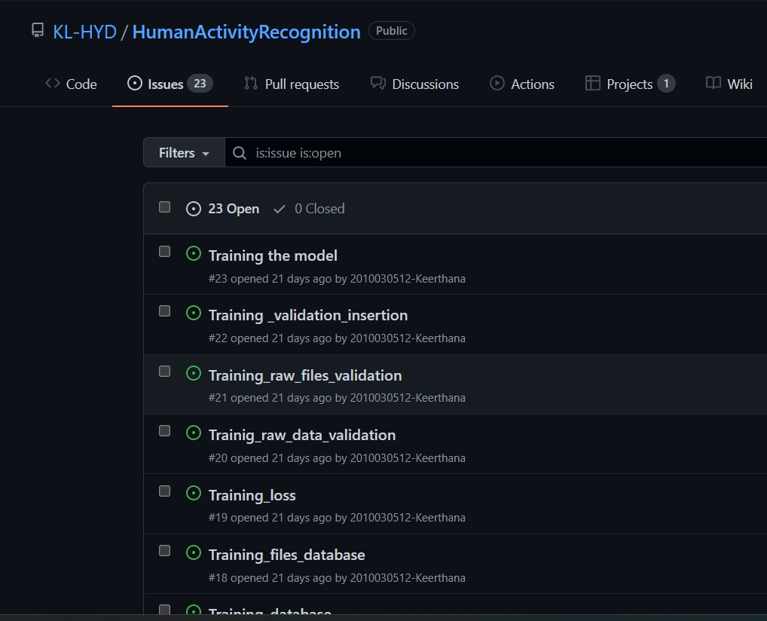
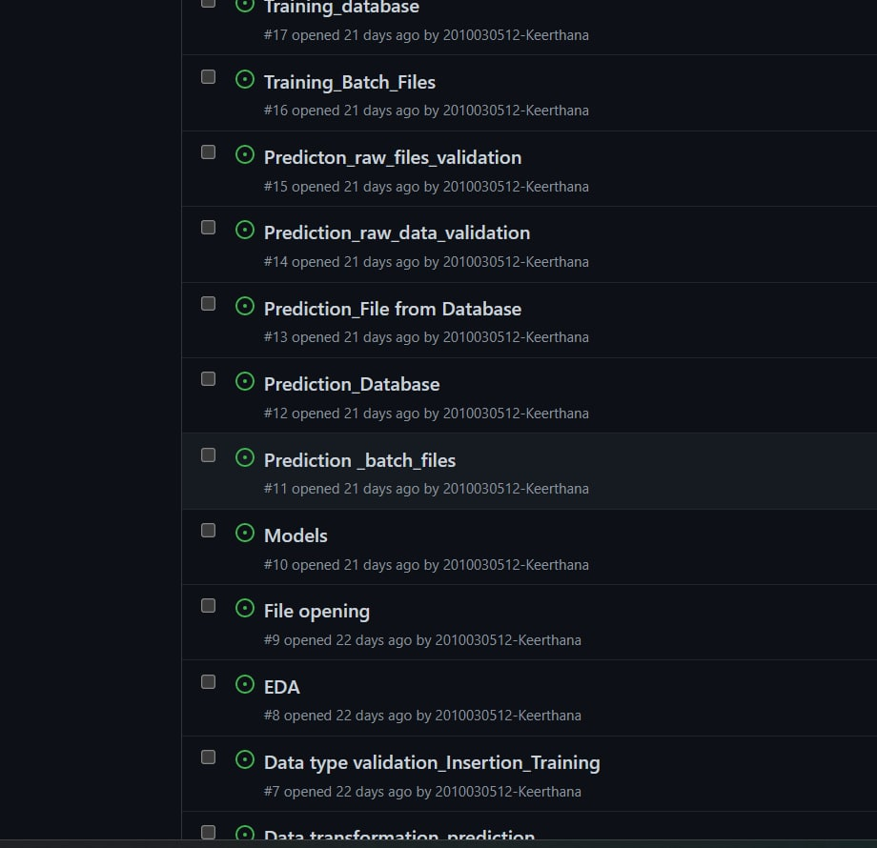
GITHUB-COMMITS

Slide 5

IMPLEMENTATION CODE

Slide 6

OUTPUT

Slide 7
SELECTED MODEL
CNN is a type of deep learning model for processing data that has a grid pattern, such as images.CNN is mainly used in image analysis tasks like Image recognition, Object detection & Segmentation.
Very Deep Convolutional Networks for Large-Scale Image Recognition(VGG-16) The VGG-16 is one of the most popular pre-trained models for image classification.
Image classification techniques can mainly be divided into two different categories: pixel-based classification and object-based classification. Pixels are the base units of an image, and the analysis of pixels is the primary way that image classification is done.
VGG16 is object detection and classification algorithm which is able to classify 1000 images of 1000 different categories with 92.7% accuracy. It is one of the popular algorithms for image classification and is easy to use with transfer learning.
VGG-16 is considered to be one of the excellent vision model architecture till date

Slide 8

THANKYOU

